Slide 1

Rutgers Bootcamp
erify
Group: Raymundo Ojeda, Scot Renz, Kelly Quinn and Mohammed Wardeh

Slide 2

Why use Verify?
Allows users to voluntarily share medical data in real time
Who is the ideal user?
Benefits?

Slide 3

How does Verify solve this?
Provides an integrated platform linking…
Users
Patients
Website hub
For doctors
For patients
Application
QR code
Health status

Slide 4
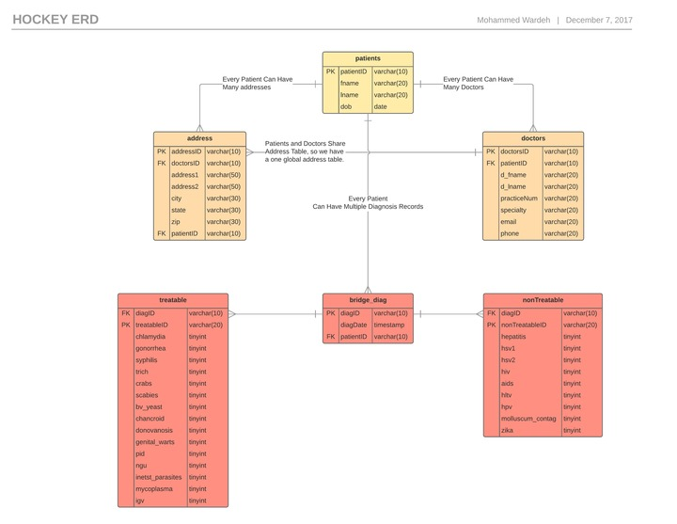
Database Structure

Slide 5
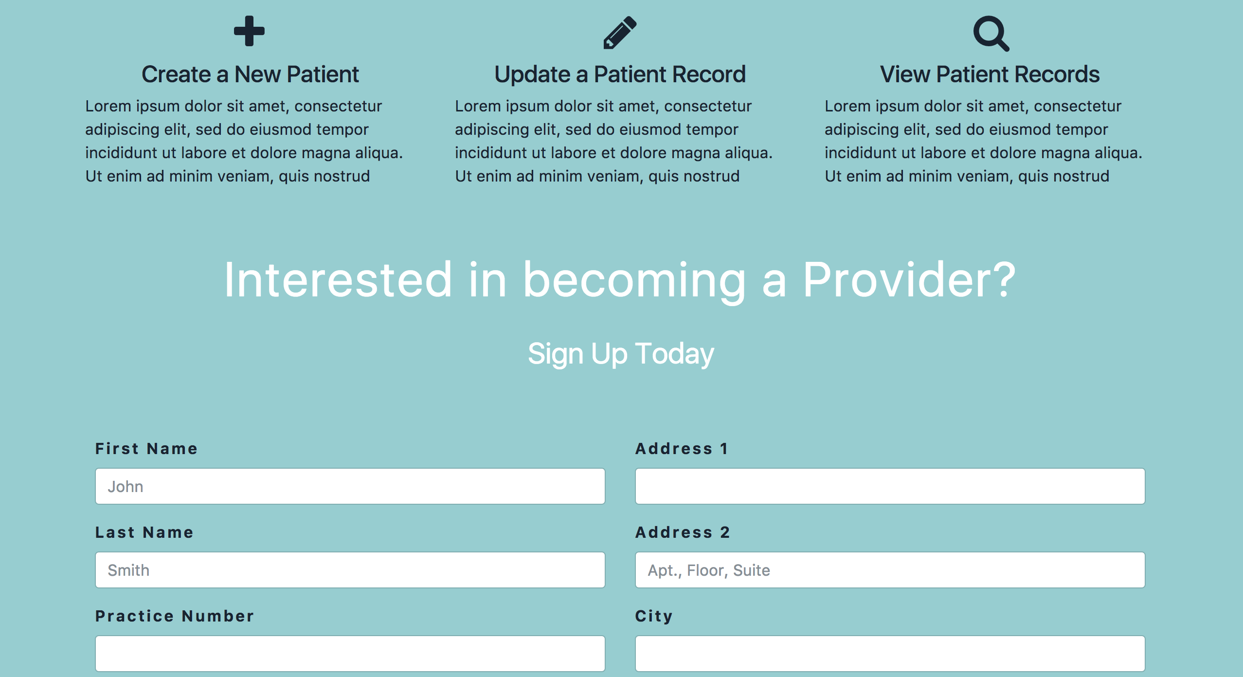
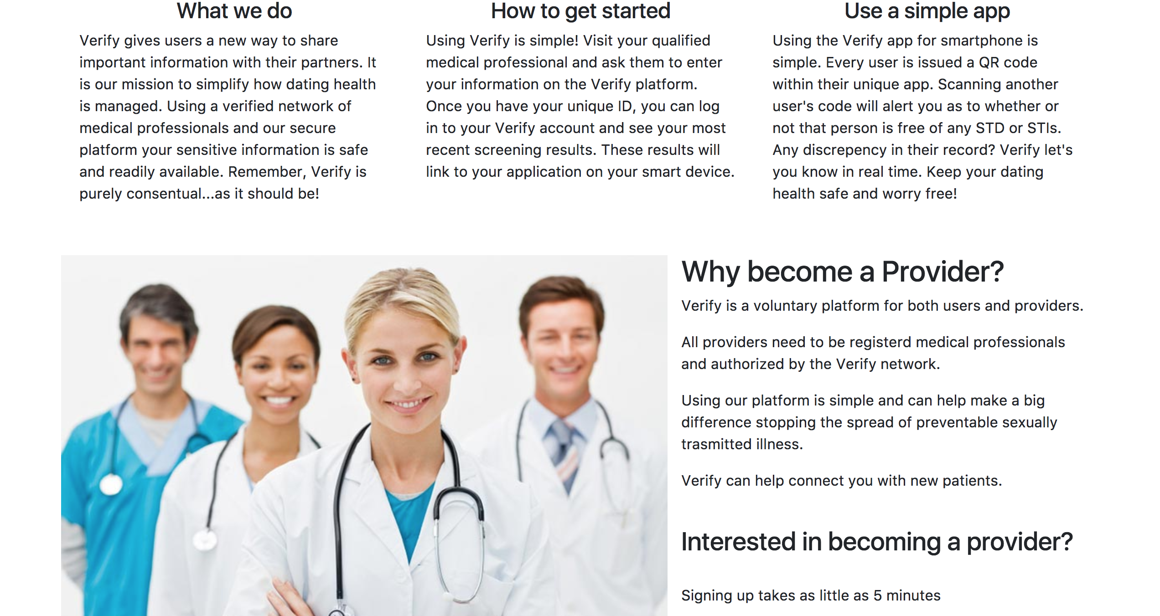
App Demonstration…

